Slide 1
Trees
Israt Jahan Rinky
Lecturer,
Dept. of CSE, Varendra University.

Slide 2
Definition:
A tree is a nonlinear data structure, compared to arrays, linked lists, stacks and queues which are linear data structures. A tree can be empty with no nodes or a tree is a structure consisting of one node called the root and zero or one or more subtrees.
A tree has following general properties:
One node is distinguished as a root;
Every node (exclude a root) is connected by a directed edge from exactly one other node; A direction is: parent -> children

Slide 3
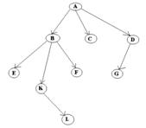
A is a parent of B, C, D, B is called a child of A. on the other hand, B is a parent of E, F, K
In the above picture, the root has 3 subtrees.
Each node can have arbitrary number of children. Nodes with no children are called leaves, or external nodes. In the above picture, C, E, F, L, G are leaves. Nodes, which are not leaves, are called internal nodes. Internal nodes have at least one child.
Nodes with the same parent are called siblings. In the picture, B, C, D are called siblings. The depth of a node is the number of edges from the root to the node. The depth of K is 2. The height of a node is the number of edges from the node to the deepest leaf. The height of B is 2. The height of a tree is a height of a root.

Slide 4
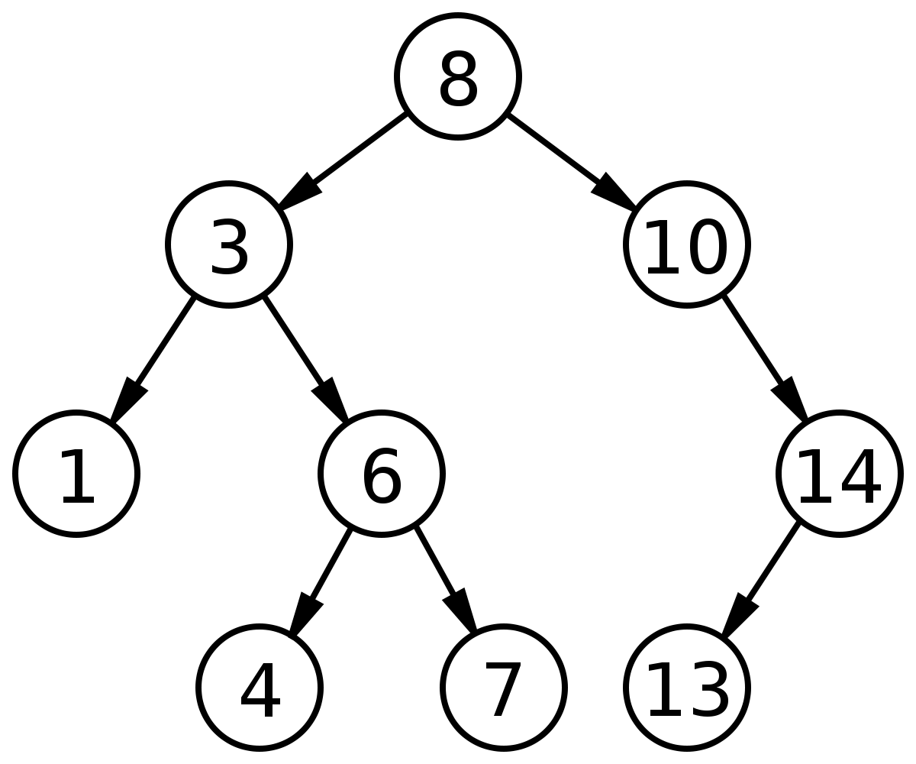
Binary Tree
In computer science, a binary tree is a tree data structure in which each node has at most two children, referred to as the left child and the right child. That is, it is a k-ary tree with k = 2.

Slide 5
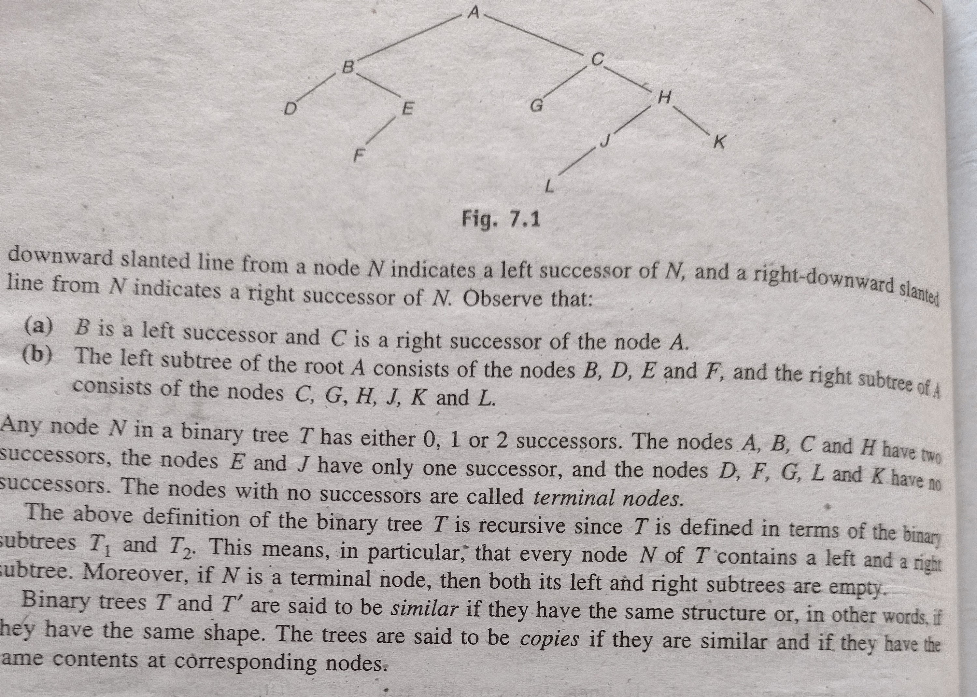

Slide 6
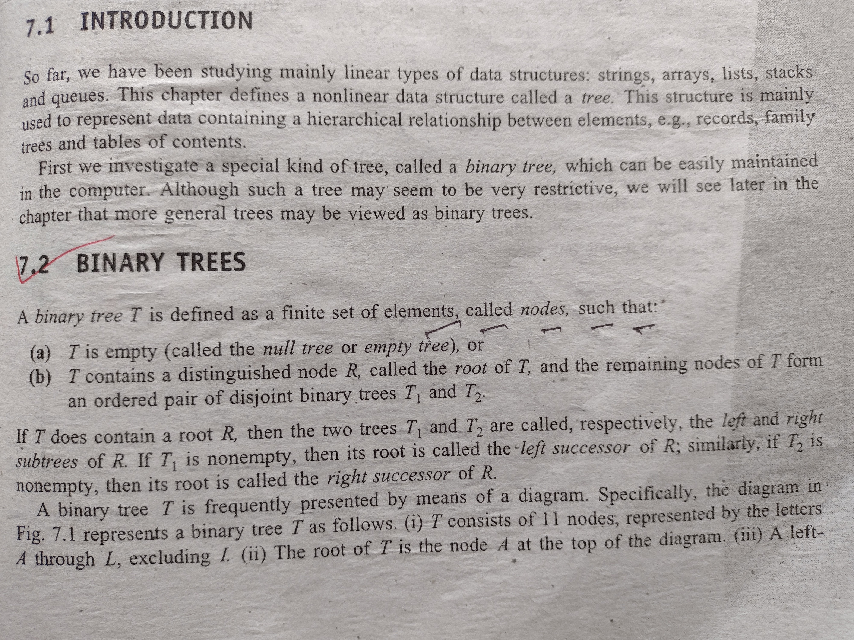

Slide 7
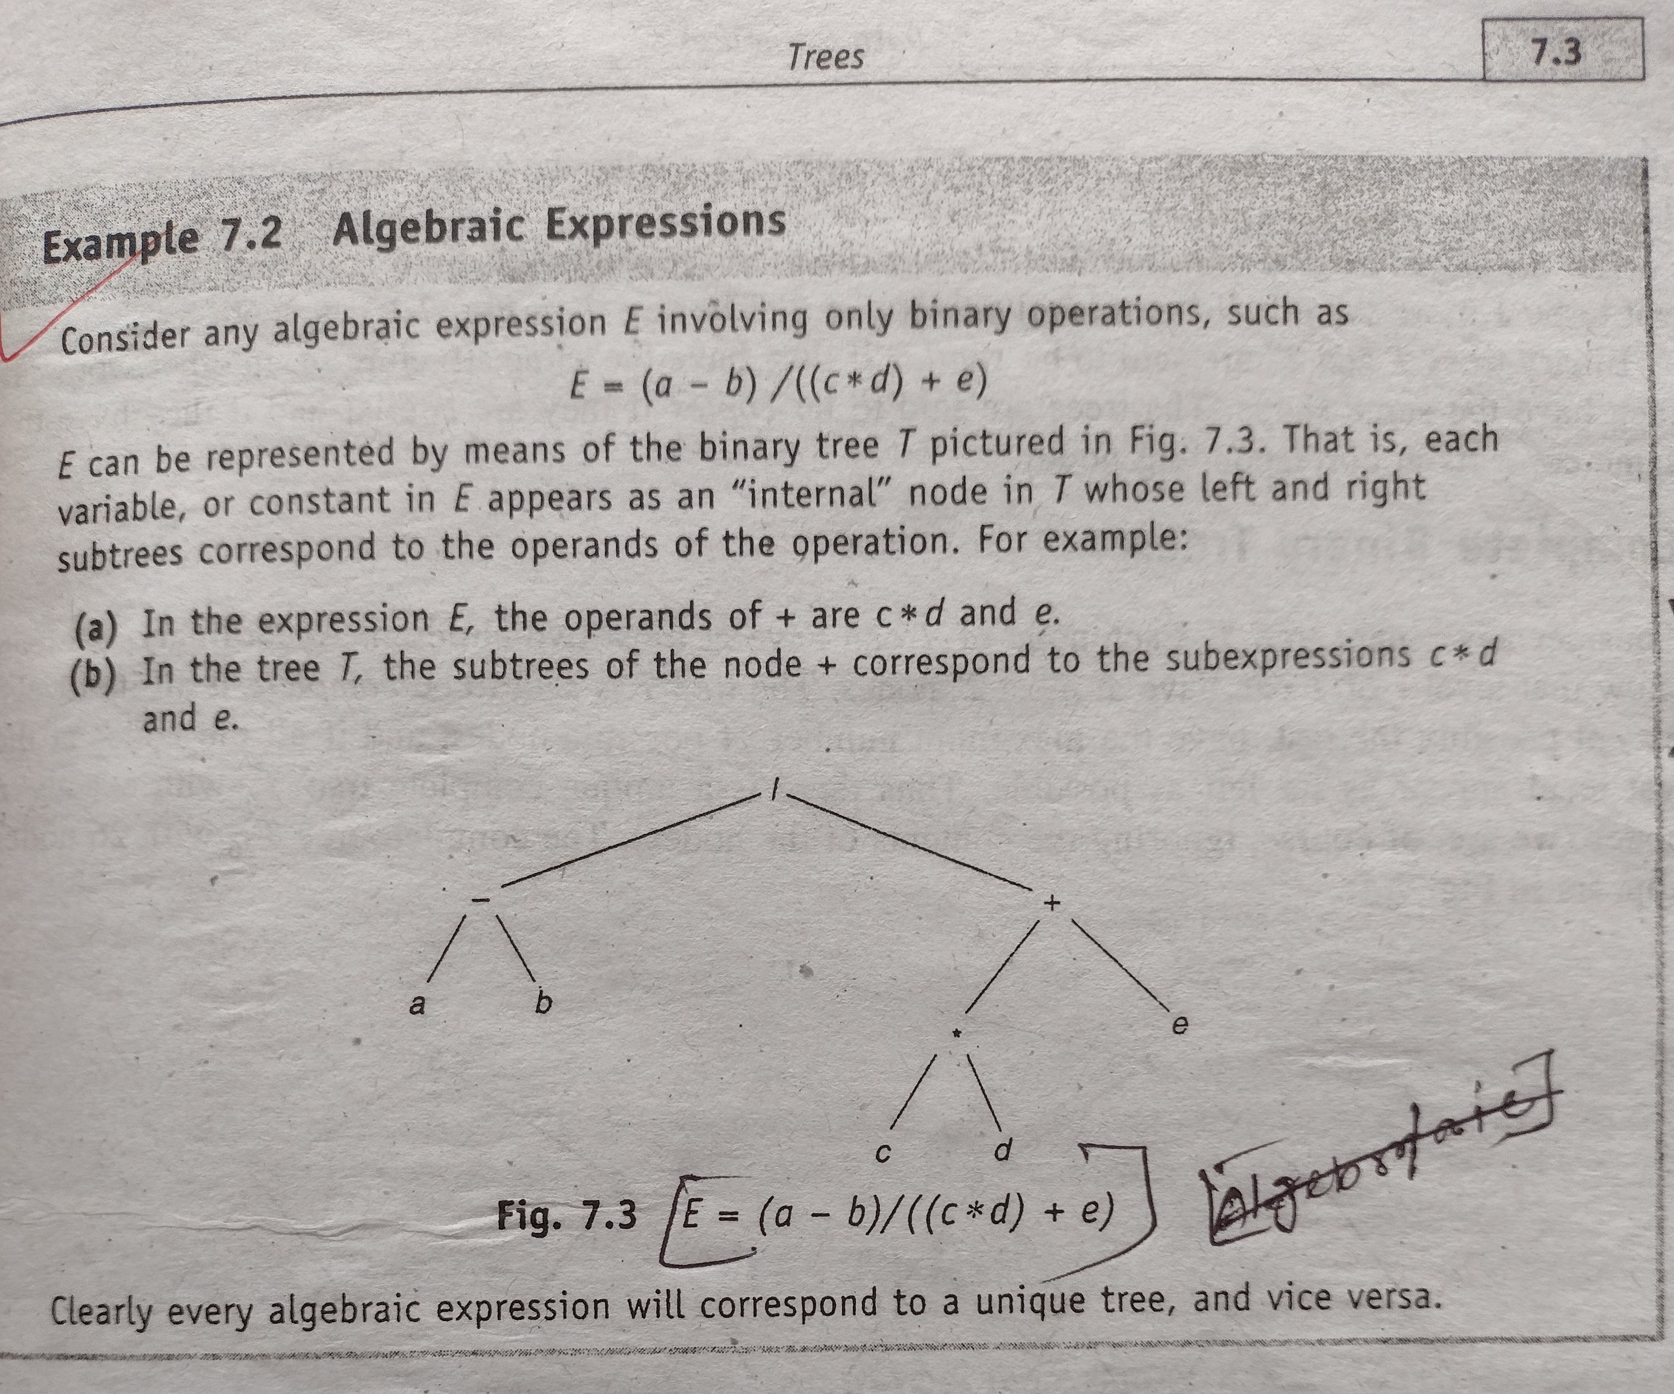

Slide 8
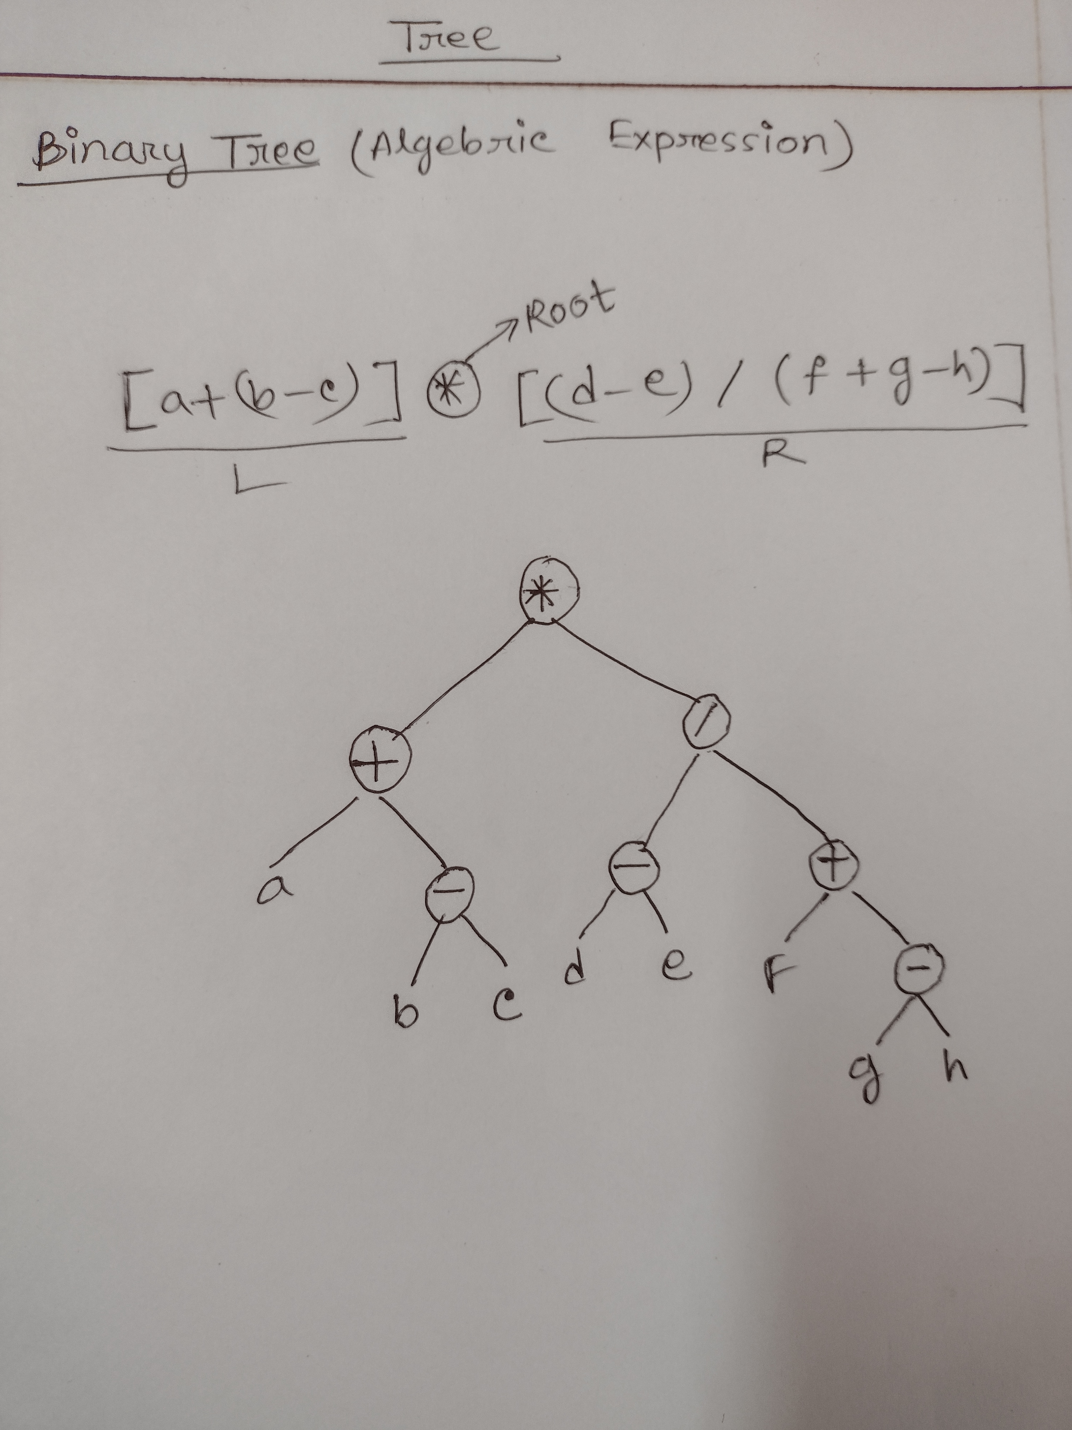
Algebraic Expression Binary Tree
[a+(b-c)]*[(d-e)/(f+g-h)]

Slide 9
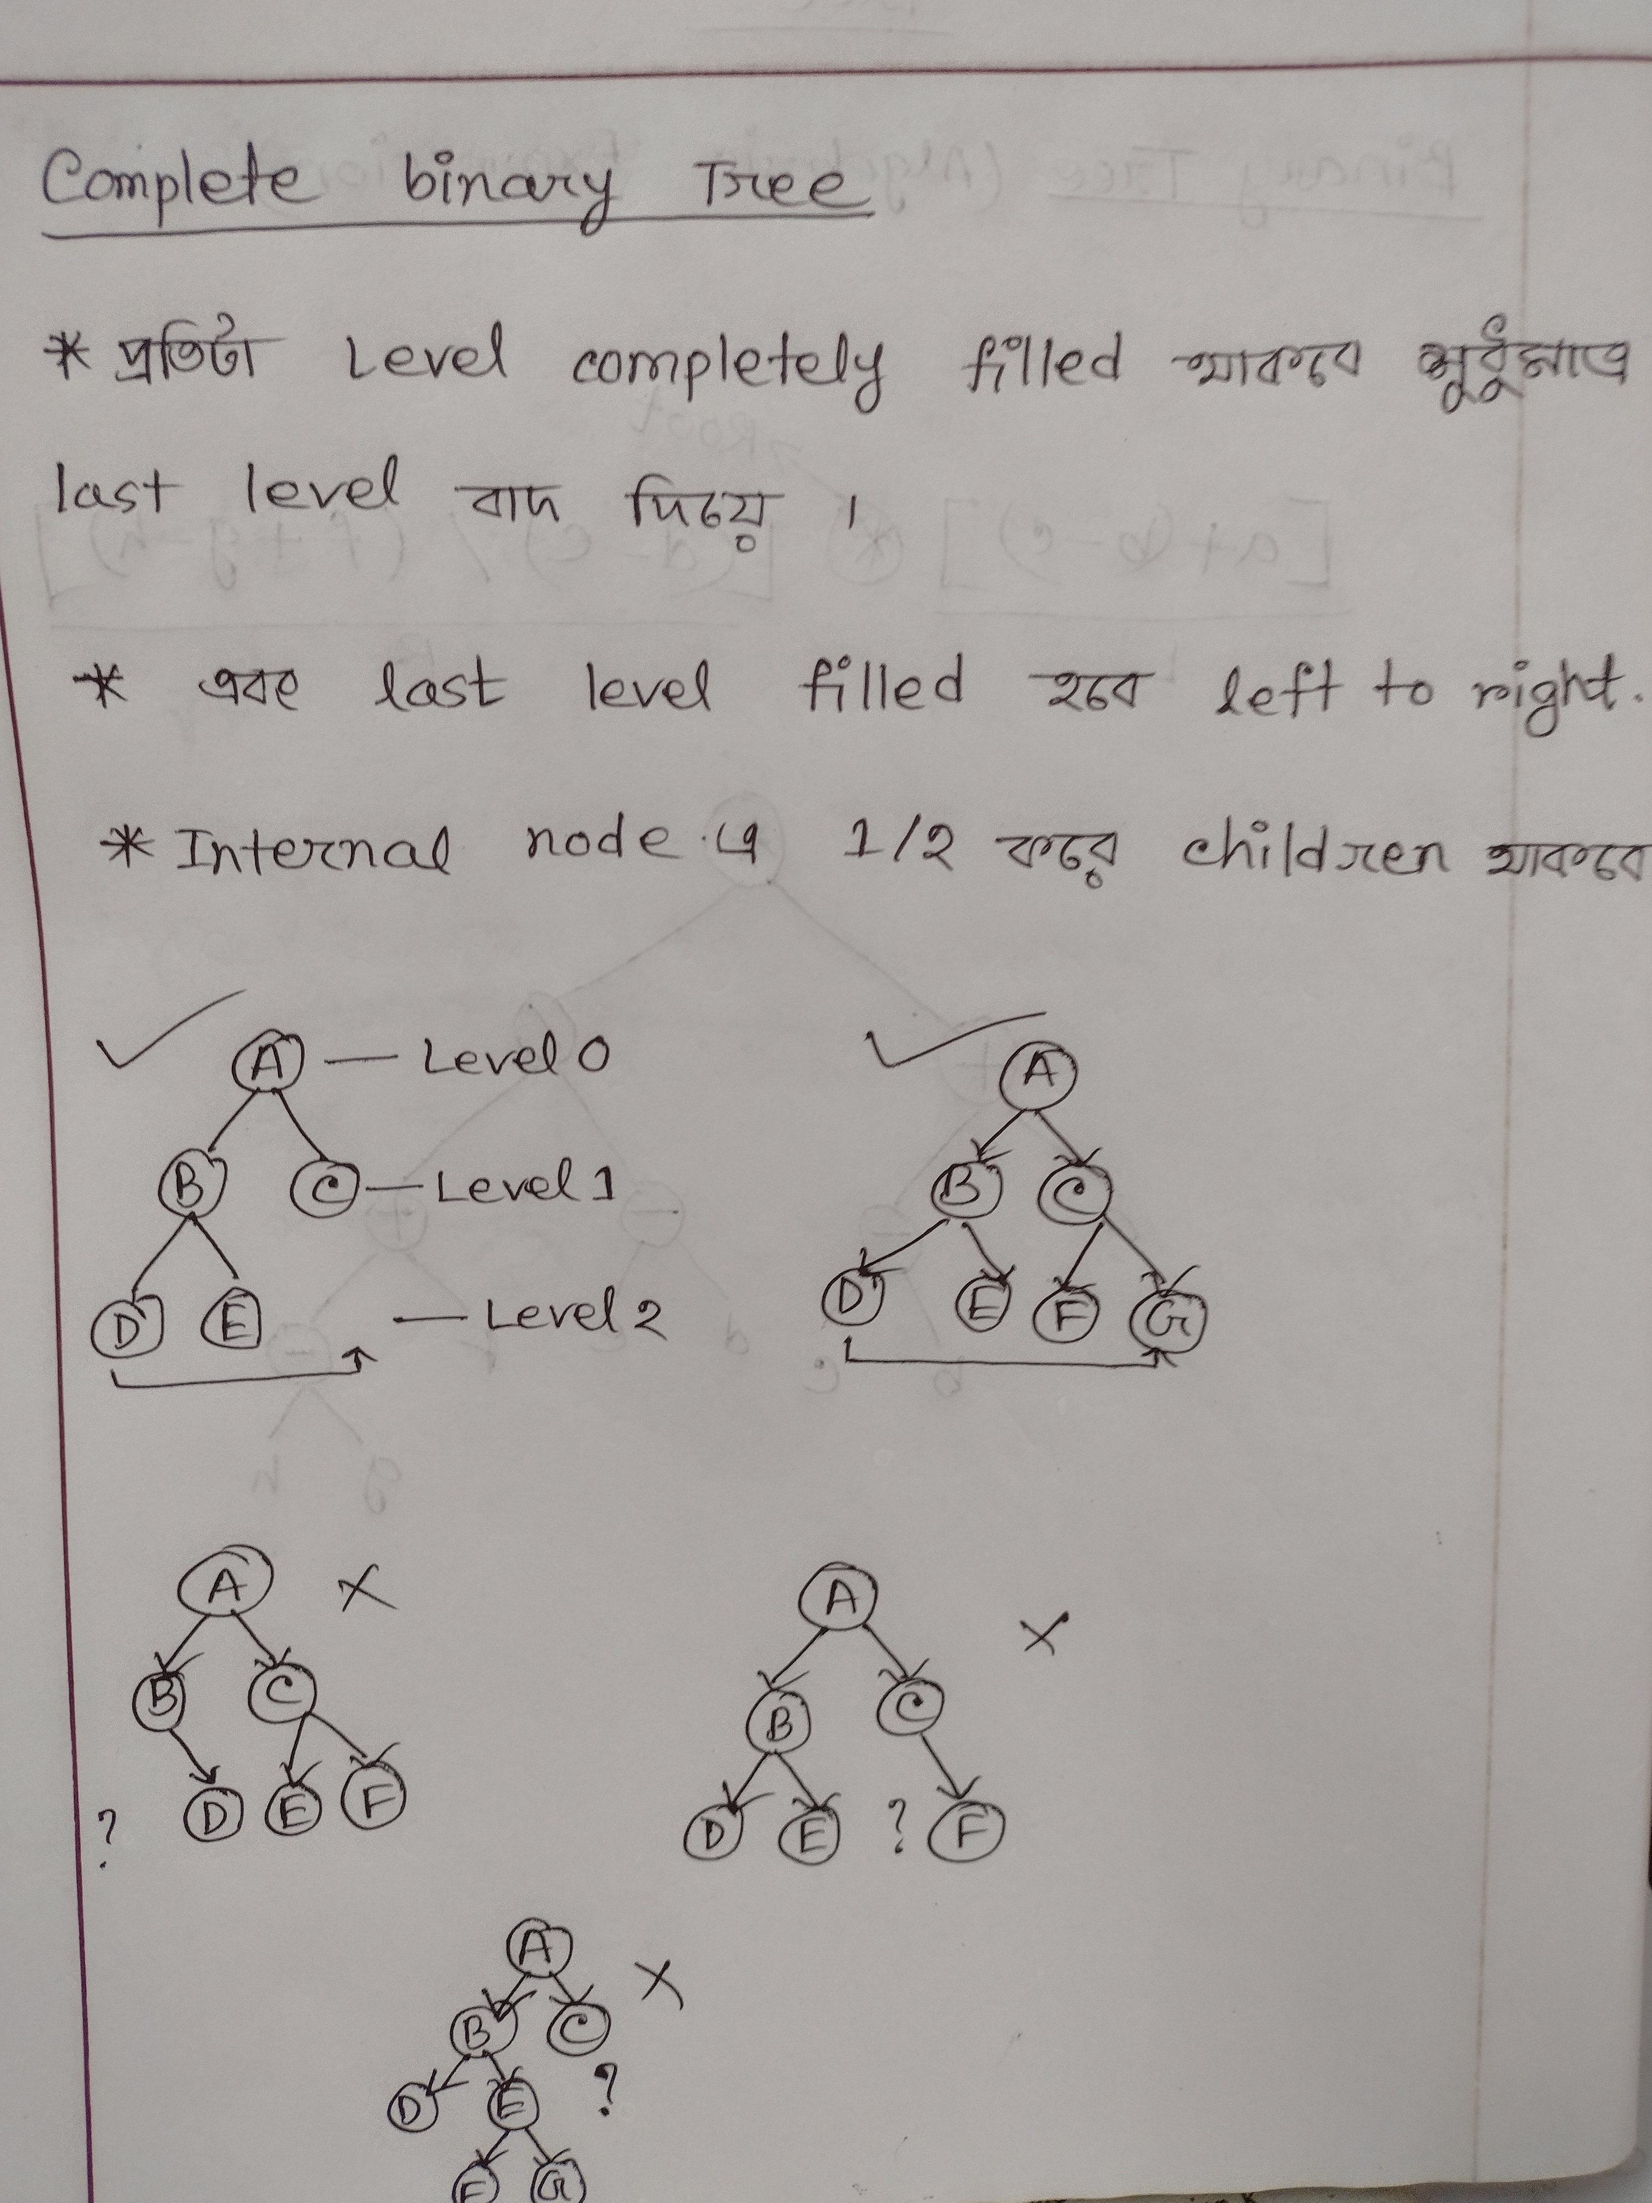

Slide 10
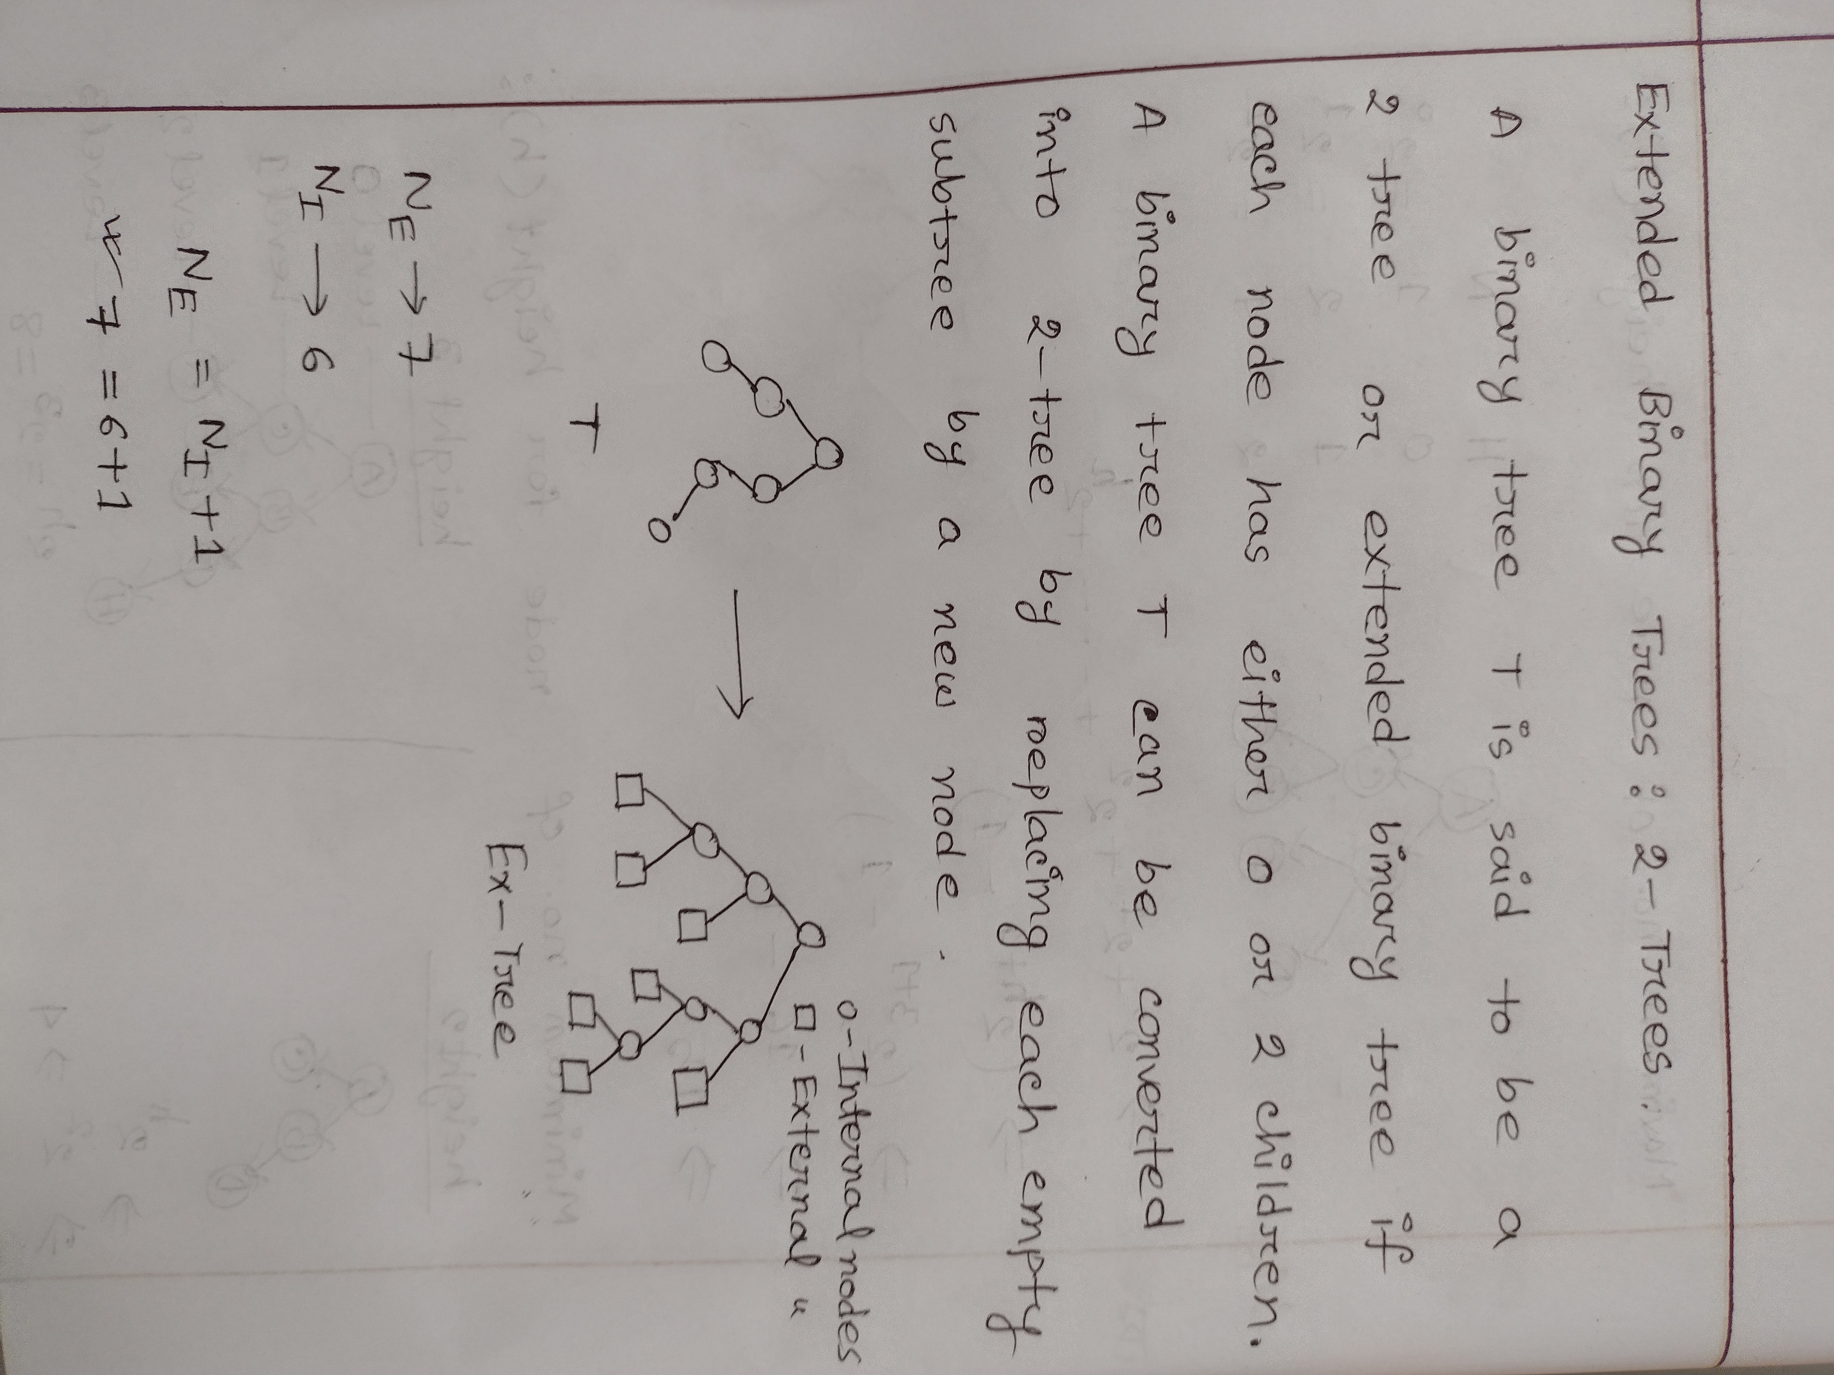

Slide 11
Traversing Binary Trees
There are three standard ways of traversing a binary tree T with root R. These three algorithms, called preorder, inorder and postorder
Preorder:
Process the root R.
Traverse the left subtree of R in preorder.
Traverse the rights subtree of R in preorder.
Inorder
Traverse the left subtree of R in inorder.
Process the root R.
Traverse the right subtree of R in inorder.
Postorder
Traverse the left subtree of R in postorder.
Traverse the right subtree of R in postorder.
Process the root R.

Slide 12
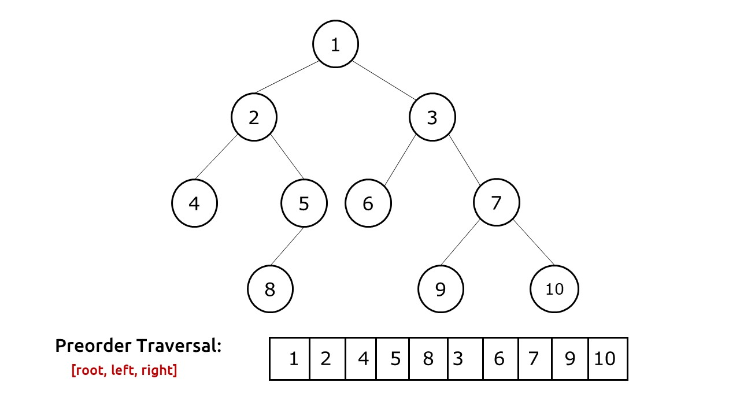
Preorder

Slide 13
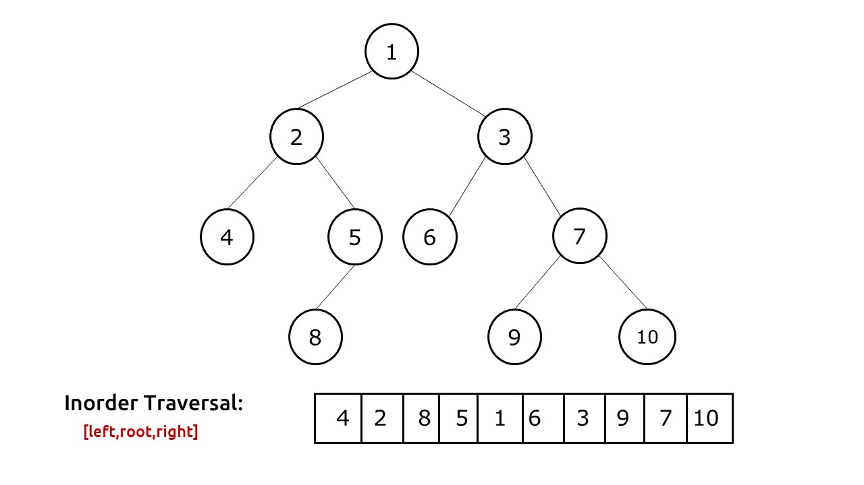
Inorder

Slide 14
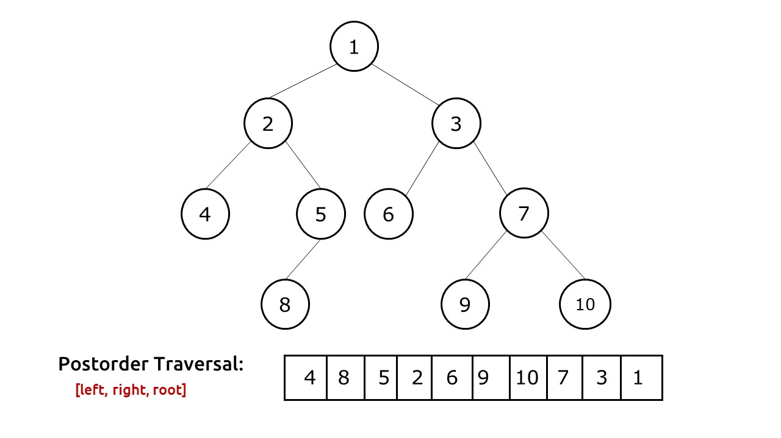
Postorder

